Slide 1
Product recommendation based on purchase history
IE 7275 Fall-2020
Final Project
Tushar Sharma

Slide 2
Problem definition
We are given 16 months of past purchase history of financial products of a bank’s customers
Product offerings are such as credit card, guarantees, loans, pensions and investments
Need to recommend them products they might be interested in
Customer demographics like age, rent, employment, residence
Find top 7 products to be recommended to each customer

Slide 3
Data Description
The downloaded files from Kaggle are training and testing dataset with information of ~950K customers and their 16-month activity
20 demographic features and 24 product purchase binaries split by purchase month
Almost all demographic features have missing values
Training data
Test data
Purchase Month
Demographics | Product purchased
……………………………. | …………………………….
Demographics
…………………………….
CustomerID
CustomerID

Slide 4
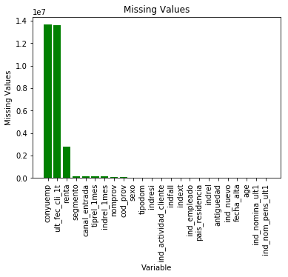
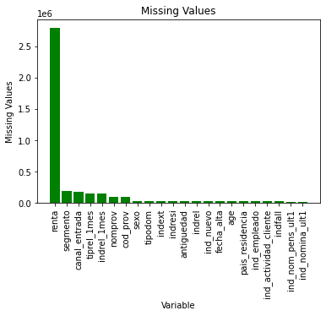
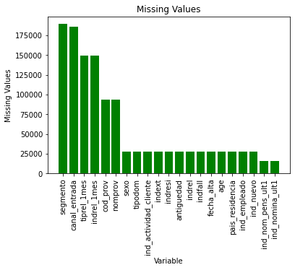
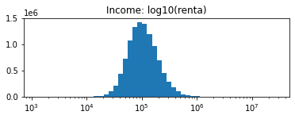
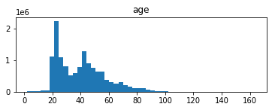
Preprocessing – Missing values & Outliers
D
O
N
E
1st 2 cols - Fill NAs
Interpolate income using simple linear regression
Interpolate variables with mode

Slide 5
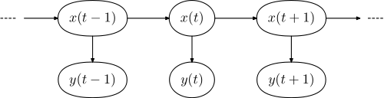
Markov Assumption
A Markov chain is a stochastic model describing a sequence of possible events in which the probability of each event depends only on the state attained in the previous event.
Discrete time MC of order 1
Discrete time MC of order 2
Notes:
Predictions can be made regarding future outcomes based solely on its present state and—most importantly—such predictions are as good as the ones that could be made knowing the process's full history

Slide 6
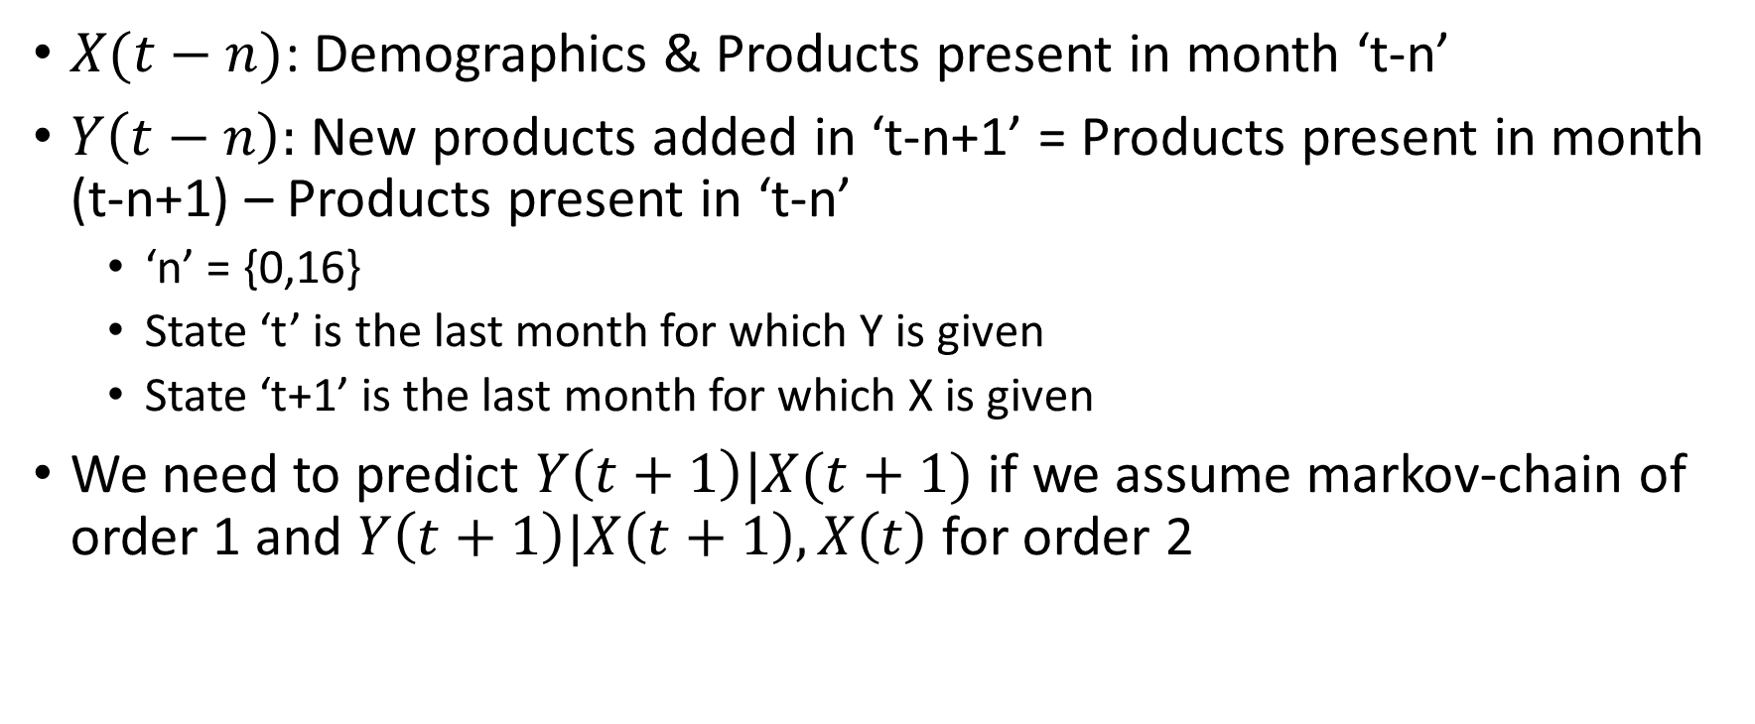
Model Formulation
$X(t−n)$: Demographics & Products present in month ‘t-n’
$Y\left(t−n\right):$ New products added in ‘t-n+1’ = Products present in month (t-n+1) – Products present in ‘t-n’
‘n’ = {0,16}
State ‘t’ is the last month for which Y is given
State ‘t+1’ is the last month for which X is given
We need to predict $Y\left(t+1\right)|X(t+1)$ if we assume markov-chain of order 1 and $Y\left(t+1\right)|X\left(t+1\right),X\left(t\right)$ for order 2

Slide 7
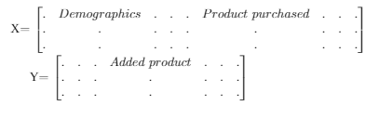
Preprocessing – Data Preparation
We need to create X and Y such that they follow our assumptions
Take a month’s data and stack in X, and products in next month and stack in Y
Subtract Products in Y with corresponding products in X to get ‘added products’
Purchase Month
Demographics | Product purchased
……………………………. | …………………………….
CustomerID

Slide 8

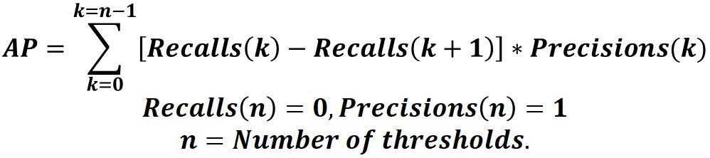
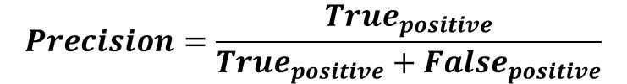
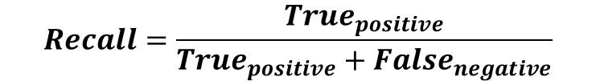
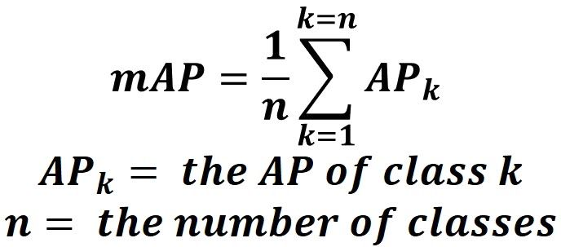
Evaluation criteria
Accuracy
Precision
Recall
Mean Average Precision

Slide 9
Proposed techniques
Decision Trees
Gradient Boosting Trees
Association rules

Slide 10
Decision Trees
DecisionTreeClassifier(random_state=40, criterion='gini',max_depth=18)
Accuracy | Precision | MAP@7
92.554% | 97.099% | 0.02339
DecisionTreeClassifier(random_state=40, criterion='gini',max_depth=5)
Accuracy | Precision | MAP@7
92.048% | 96.540% | 0.02339

Slide 11
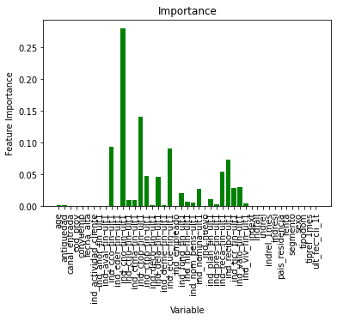
Decision Trees

Slide 12
Proposed techniques
Decision Trees
Gradient Boosting Trees
Association rules

Slide 13
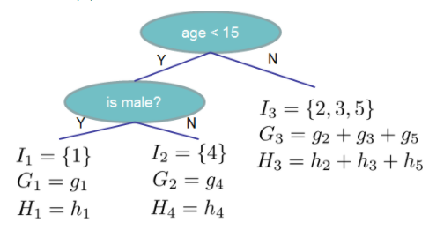


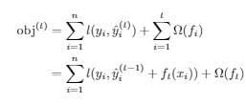


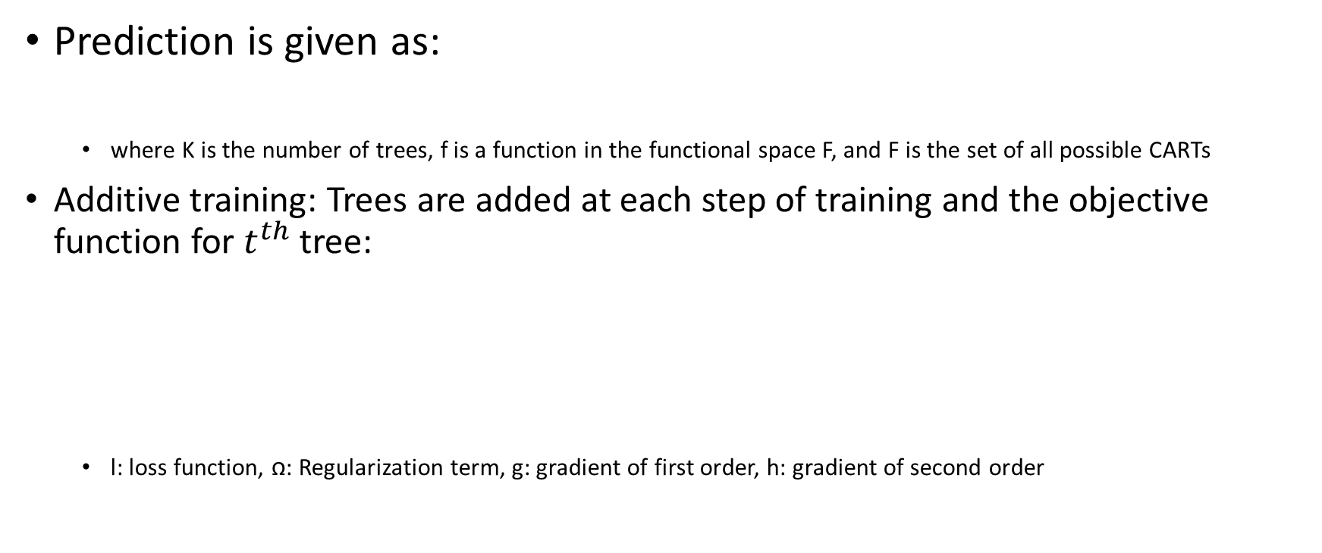
Gradient Boosting Trees
Prediction is given as:
where K is the number of trees, f is a function in the functional space F, and F is the set of all possible CARTs
Additive training: Trees are added at each step of training and the objective function for $t^{th}$ tree:
l: loss function, ꭥ: Regularization term, g: gradient of first order, h: gradient of second order

Slide 14
Gradient Boosting Trees
GradientBoostingClassifier(n_estimators=100, learning_rate=0.1, max_depth=3,random_state=0,subsample=0.5)
Accuracy | Precision | MAP@7
92.554% | 97.003% | 0.02283
GradientBoostingClassifier(n_estimators=50, learning_rate=0.1, max_depth=1,random_state=0,subsample=0.5)
Accuracy | Precision | MAP@7
92.048% | 96.540% | 0.02312
GradientBoostingClassifier(n_estimators=300, learning_rate=0.1, max_depth=1,random_state=0,subsample=0.5)
Accuracy | Precision | MAP@7
92.706% | 96.844% | 0.02312

Slide 15
Proposed techniques
Decision Trees
Gradient Boosting Trees
Association rules

Slide 16
Association Rule Mining
We consider only products purchased to find frequent purchasing patterns
Rules are learnt using Fpgrowth algorithm
fpgrowth(train, min_support=0.00001, use_colnames=False, max_len=None, verbose=0)
The rules are filtered to get consequents as 1-itemset
Using learned rules we use confidence as a product scoring metric and predict recommendations for next month
MAP@7
0.01144

Slide 17
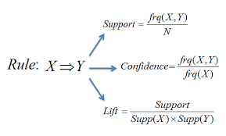
Association Rule Mining
support | itemsets | Description
0.650577 | (ind_cco_fin_ult1) | Current Accounts
0.061361 | (ind_tjcr_fin_ult1) | Credit Card
0.038844 | (ind_ctpp_fin_ult1) | particular Plus Account
0.025175 | (ind_valo_fin_ult1) | Securities
0.164312 | (ind_recibo_ult1) | Direct Debit

Slide 18
Association Rule Mining
antecedents | consequents | antecedent support | consequent support | support | confidence | lift
(ind_tjcr_fin_ult1, ind_ctju_fin_ult1, ind_cco... | (ind_ecue_fin_ult1) | 0.000010 | 0.085633 | 0.000010 | 1.0 | 11.677795
(ind_tjcr_fin_ult1, ind_ecue_fin_ult1, ind_rec... | (ind_nomina_ult1) | 0.000024 | 0.073545 | 0.000024 | 1.0 | 13.597206
(ind_tjcr_fin_ult1, ind_ecue_fin_ult1, ind_rec... | (ind_nom_pens_ult1) | 0.000020 | 0.078929 | 0.000020 | 1.0 | 12.669620
(ind_plan_fin_ult1, ind_nom_pens_ult1, ind_cco... | (ind_recibo_ult1) | 0.000038 | 0.164312 | 0.000038 | 1.0 | 6.085993
(ind_tjcr_fin_ult1, ind_ecue_fin_ult1, ind_rec... | (ind_recibo_ult1) | 0.000024 | 0.164312 | 0.000024 | 1.0 | 6.085993

Slide 19
Conclusions
Product purchased features are more important than demographics in recommendation

Slide 20
Future Work and Improvements
Since products purchased are most important features there is scope to improve association rules technique
We should consider markov chains of order > 1 for classification
Sequential modelling such as Hidden markov model and Recurrent Neural Networks can be explored to learn transition probabilities

Slide 21
Thank You
Question and Comments

